Slide 1

Preferential Weld Corrosion
13th May 2019

Slide 2
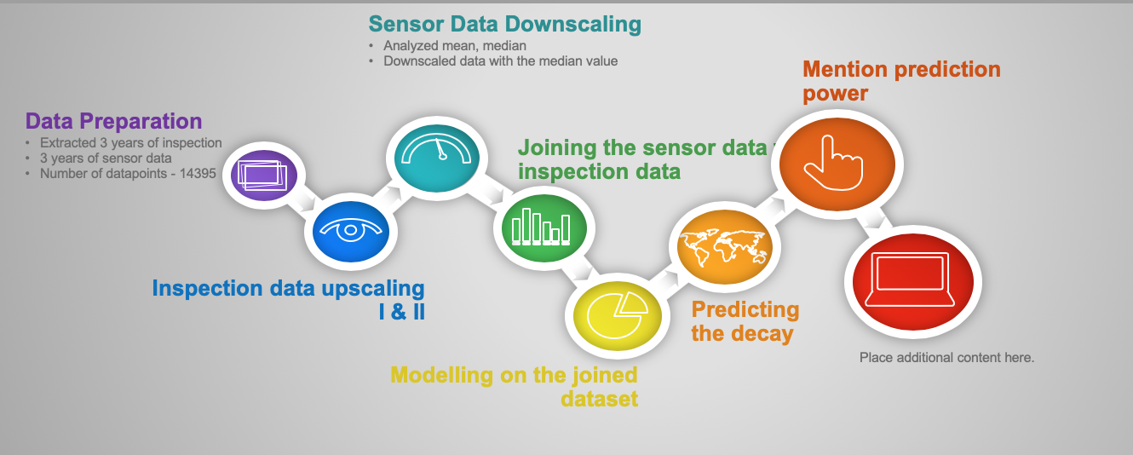
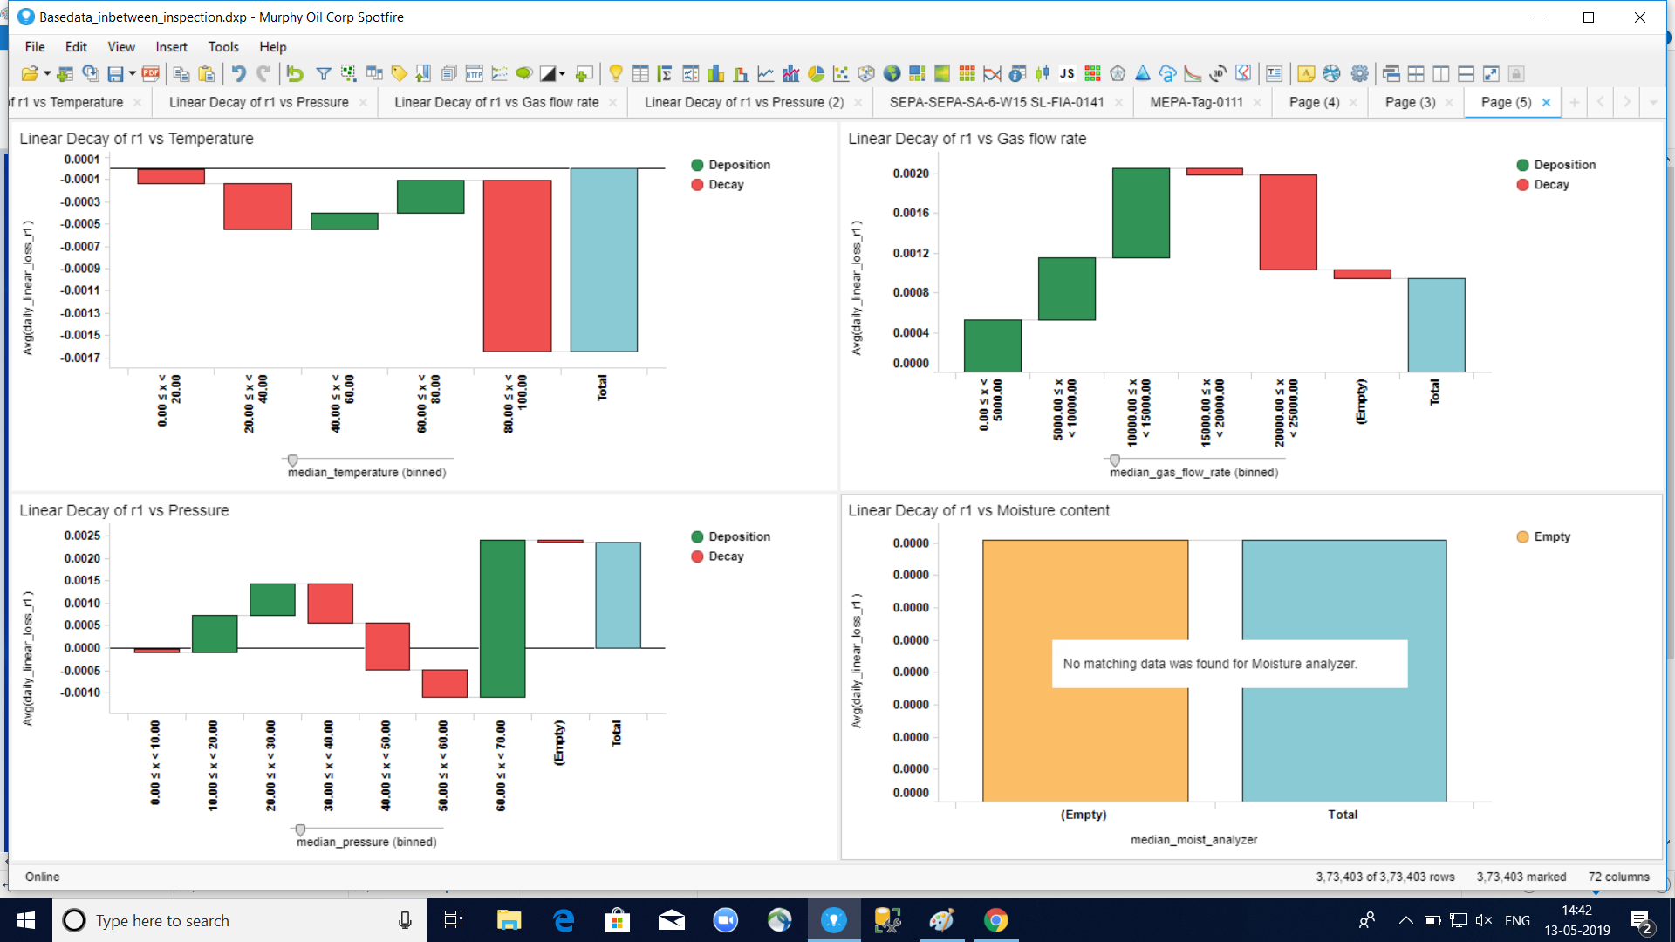
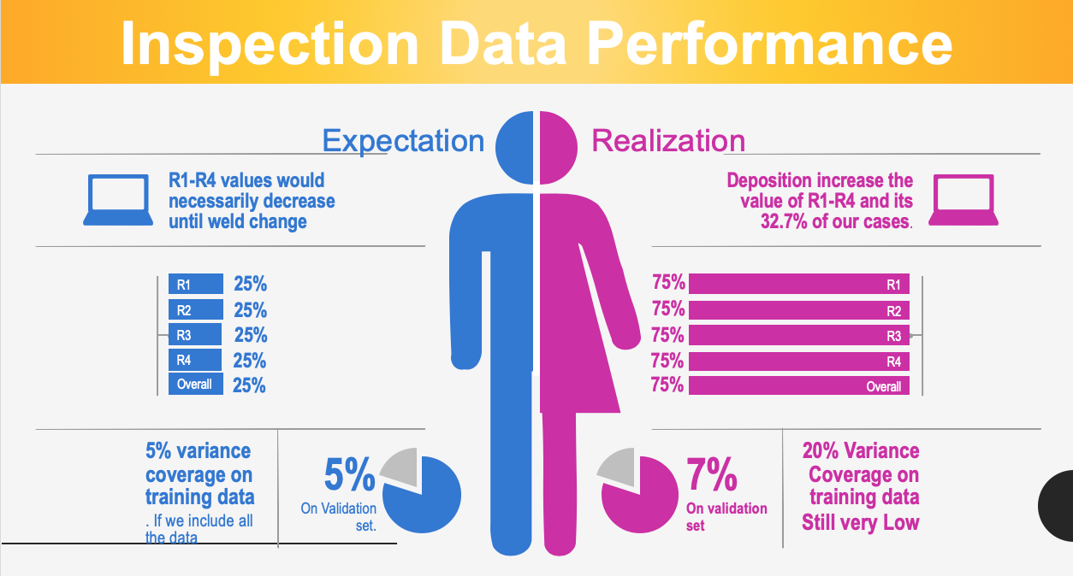
Overview

Slide 3
Sample 2
Overall Process and Insight
Sensor Data Downscaling
Analyzed mean, median
Downscaled data with the median value
Mention prediction power
Data Preparation
Extracted 3 years of inspection
3 years of sensor data
Number of datapoints - 14395
Joining the sensor data with inspection data
Inspection data upscaling I & II
Predicting the decay
Place additional content here.
Modelling on the joined dataset

Slide 4
Data Preparation
Sample Set
Last Three year (2016-2018) Data was selected
6754 total data points of Weld data
286 Number of Weld changes
Inspection Data Up-Scaling-I
The difference between two consecutive inspection was taken for R1-R4
The gap in terms of days between the two inspection was calculated.
The degradation id linearly distributed across the days: Diff (r1 new – r1 old)/No of days
SOURCE

Slide 5
Inspection Data Performance
Expectation
Realization
R1-R4 values would necessarily decrease until weld change
Deposition increase the value of R1-R4 and its 32.7% of our cases.
25%
75%
R1
R1
R2
25%
75%
R2
R3
25%
75%
R3
R4
25%
75%
R4
Overall
25%
75%
Overall
5% variance coverage on training data
. If we include all the data
20% Variance Coverage on training data
Still very Low
5%
On Validation set.
7%
On validation set

Slide 6

Inspection Data Performance
Inspection Data
Inspection Data with sensor
Percentage of missing data for each of the parameters
Percentage of present data for each of the parameters
Temperature
9.4%
90.6%
Temperature
Pressure
85.56%
14.44%
Pressure
Moisture
9.4%
90.6%
R3
Flow Rate
9.4%
90.6%
R4
Overall
86.56%
13.44%
Overall
20% variance coverage on training data
. If we include all the data
25% Variance Coverage on training data
Still very Low
7%
On Validation set.
24%
On validation set

Slide 7
Understanding Inspection Data Up-scaling - I
Sample data is as shown on the left
Only the relevant columns which have been used for up-scaling inspection data has been shown here
Let’s see how this data would be up-scaled

Slide 8
Understanding Inspection Data Up-scaling – I (contd.)

Slide 9
Understanding Inspection Data Up-scaling – II

Slide 10
Weld Change Instances Remarks
Changed spool from CS to DSS
Changed spool from CS to CS
Changed to new spool
Spool has been replace to LTCS on 1/10/2018
Replaced spool & performed inspection

Slide 11
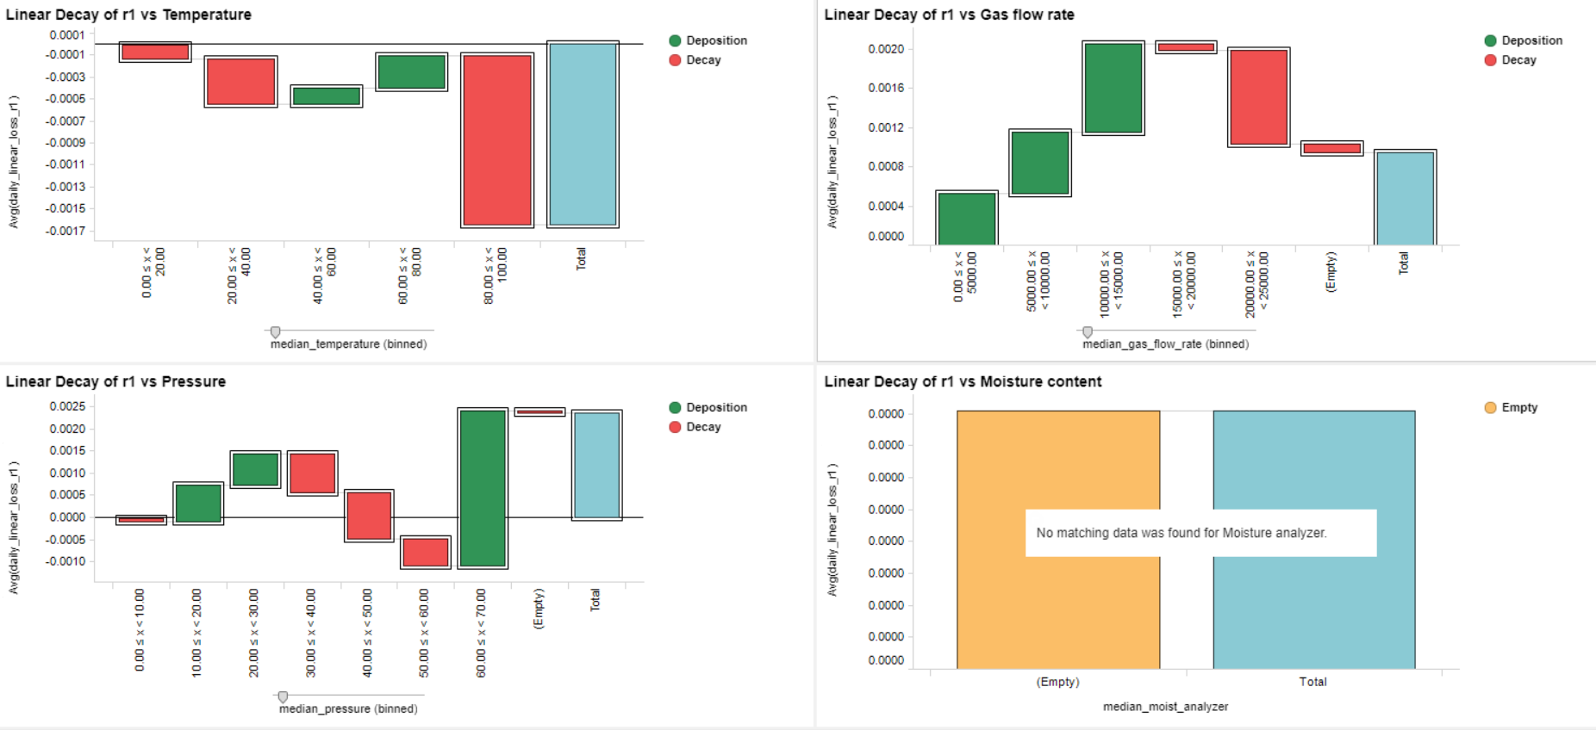
Overall Observations

Slide 12
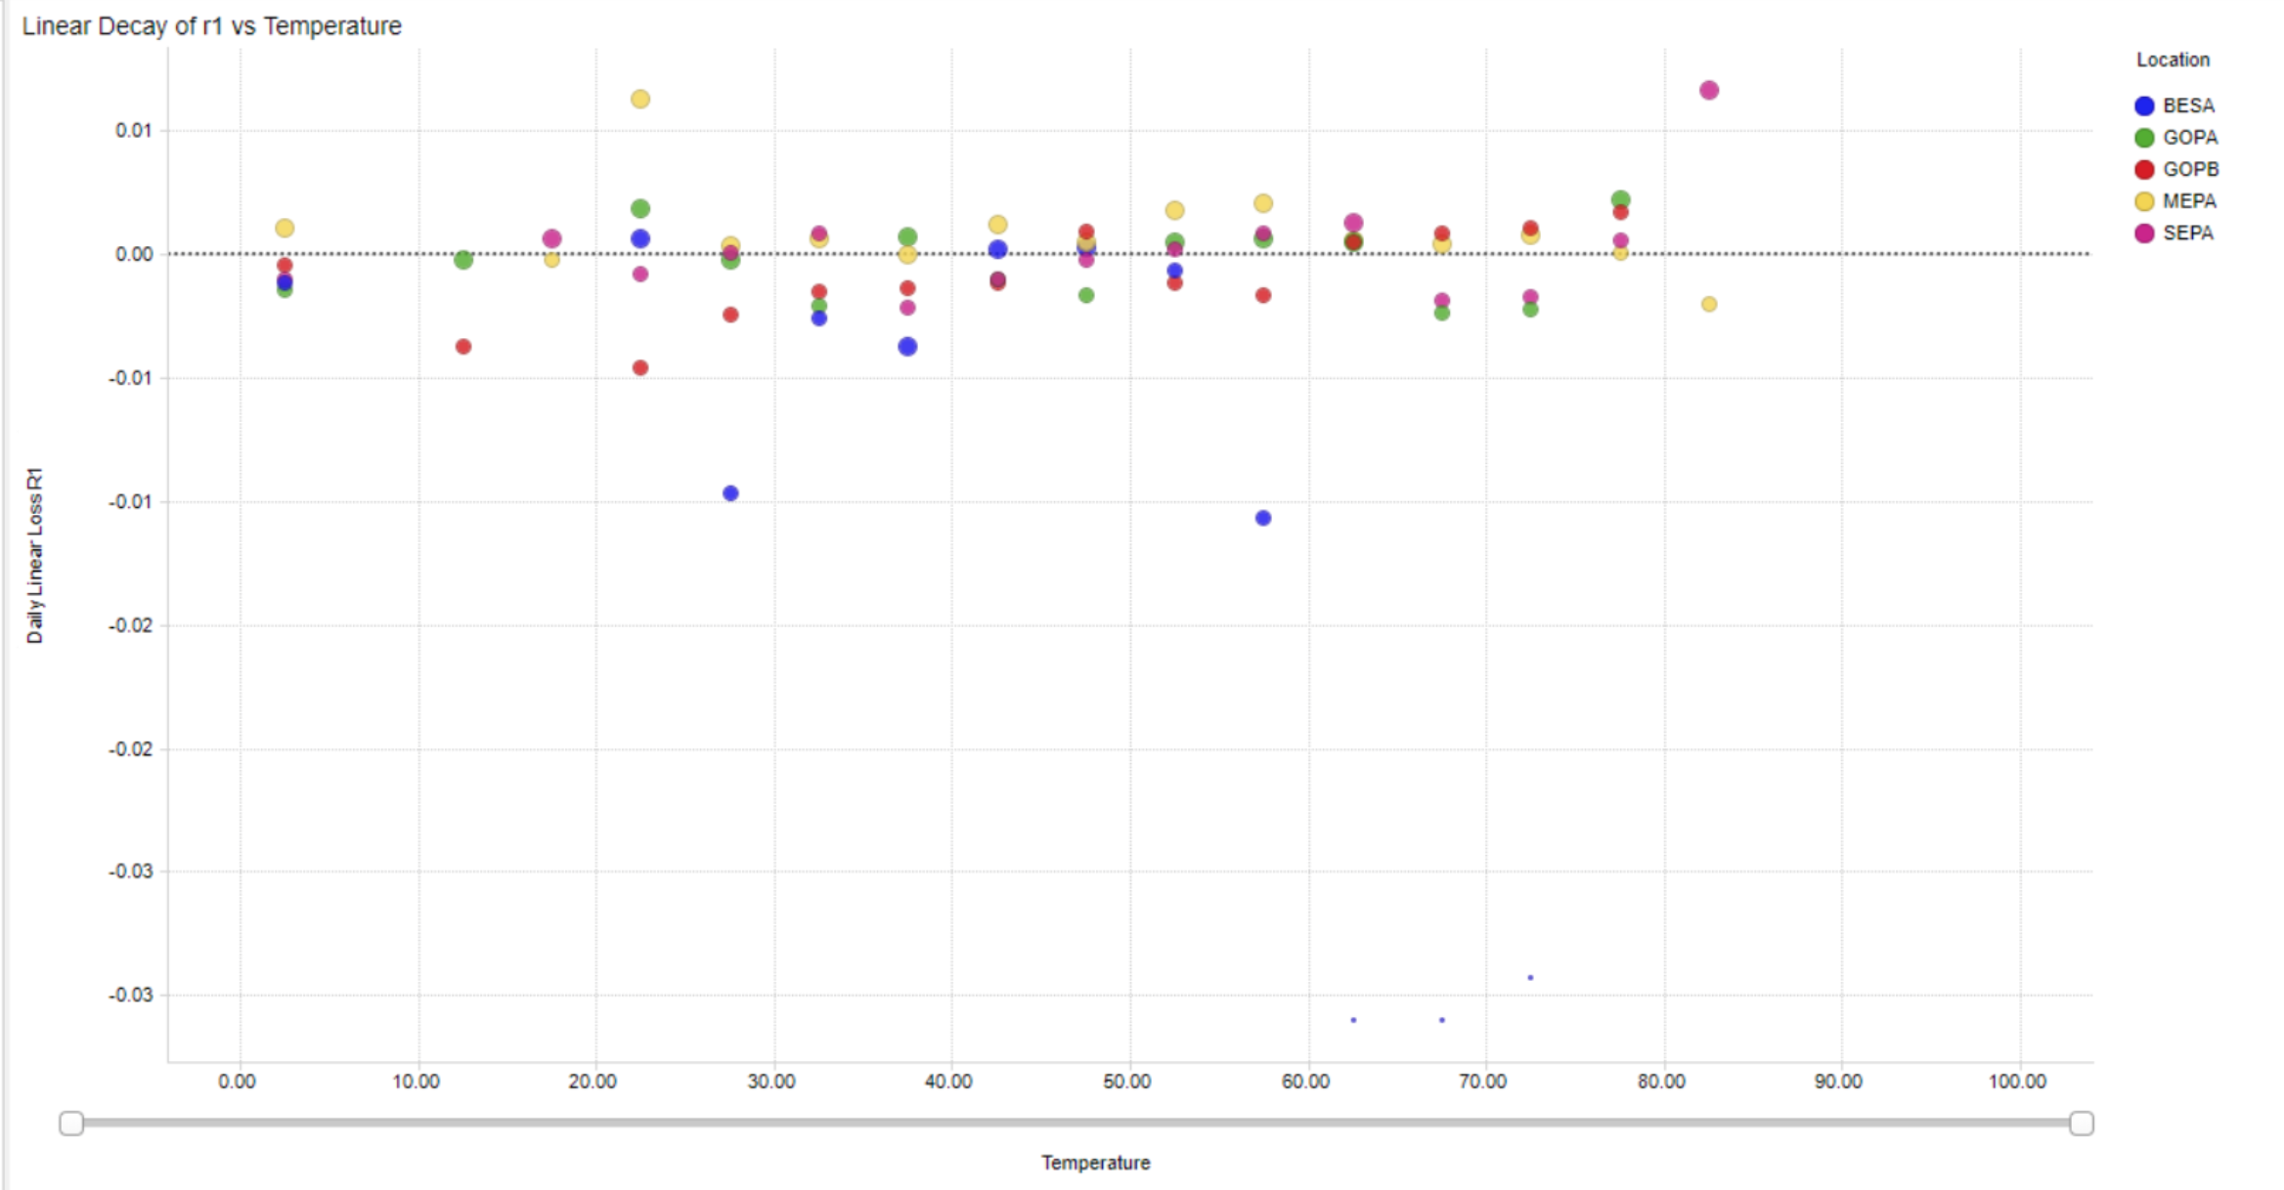
Linear Decay of r1 over Temperature

Slide 13
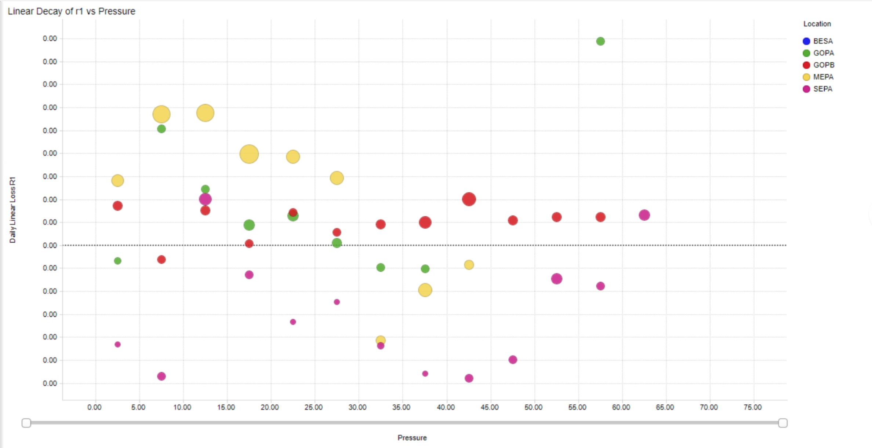
Linear Decay of r1 over Pressure

Slide 14
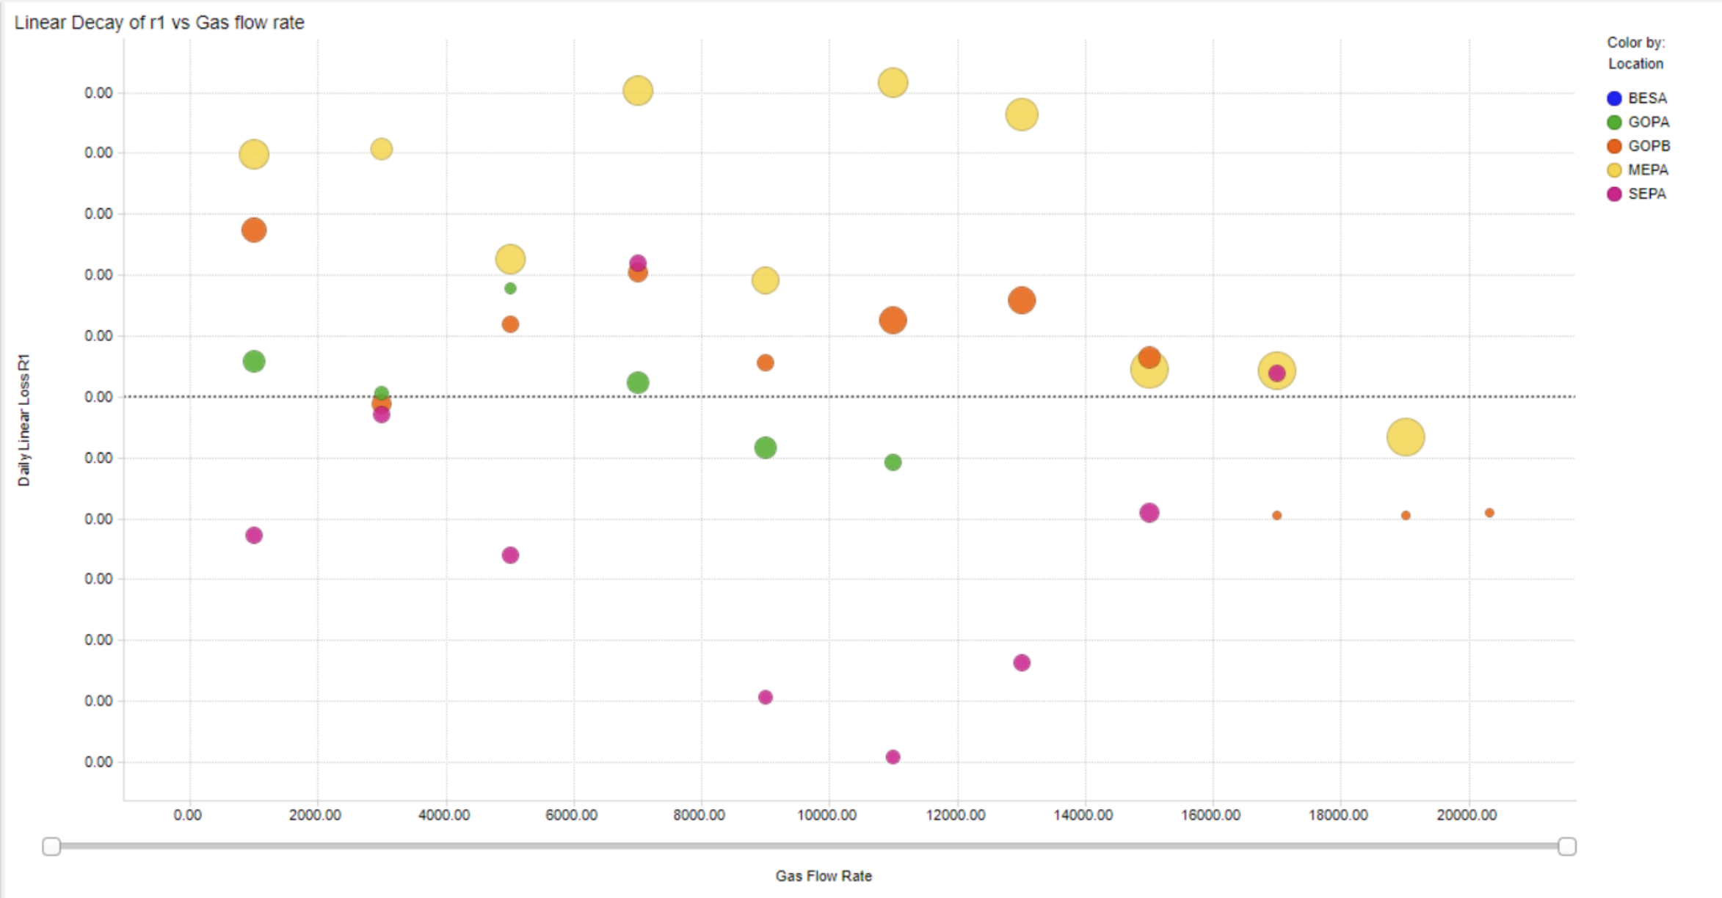
Linear Decay of r1 over Gas flow rate

Slide 15
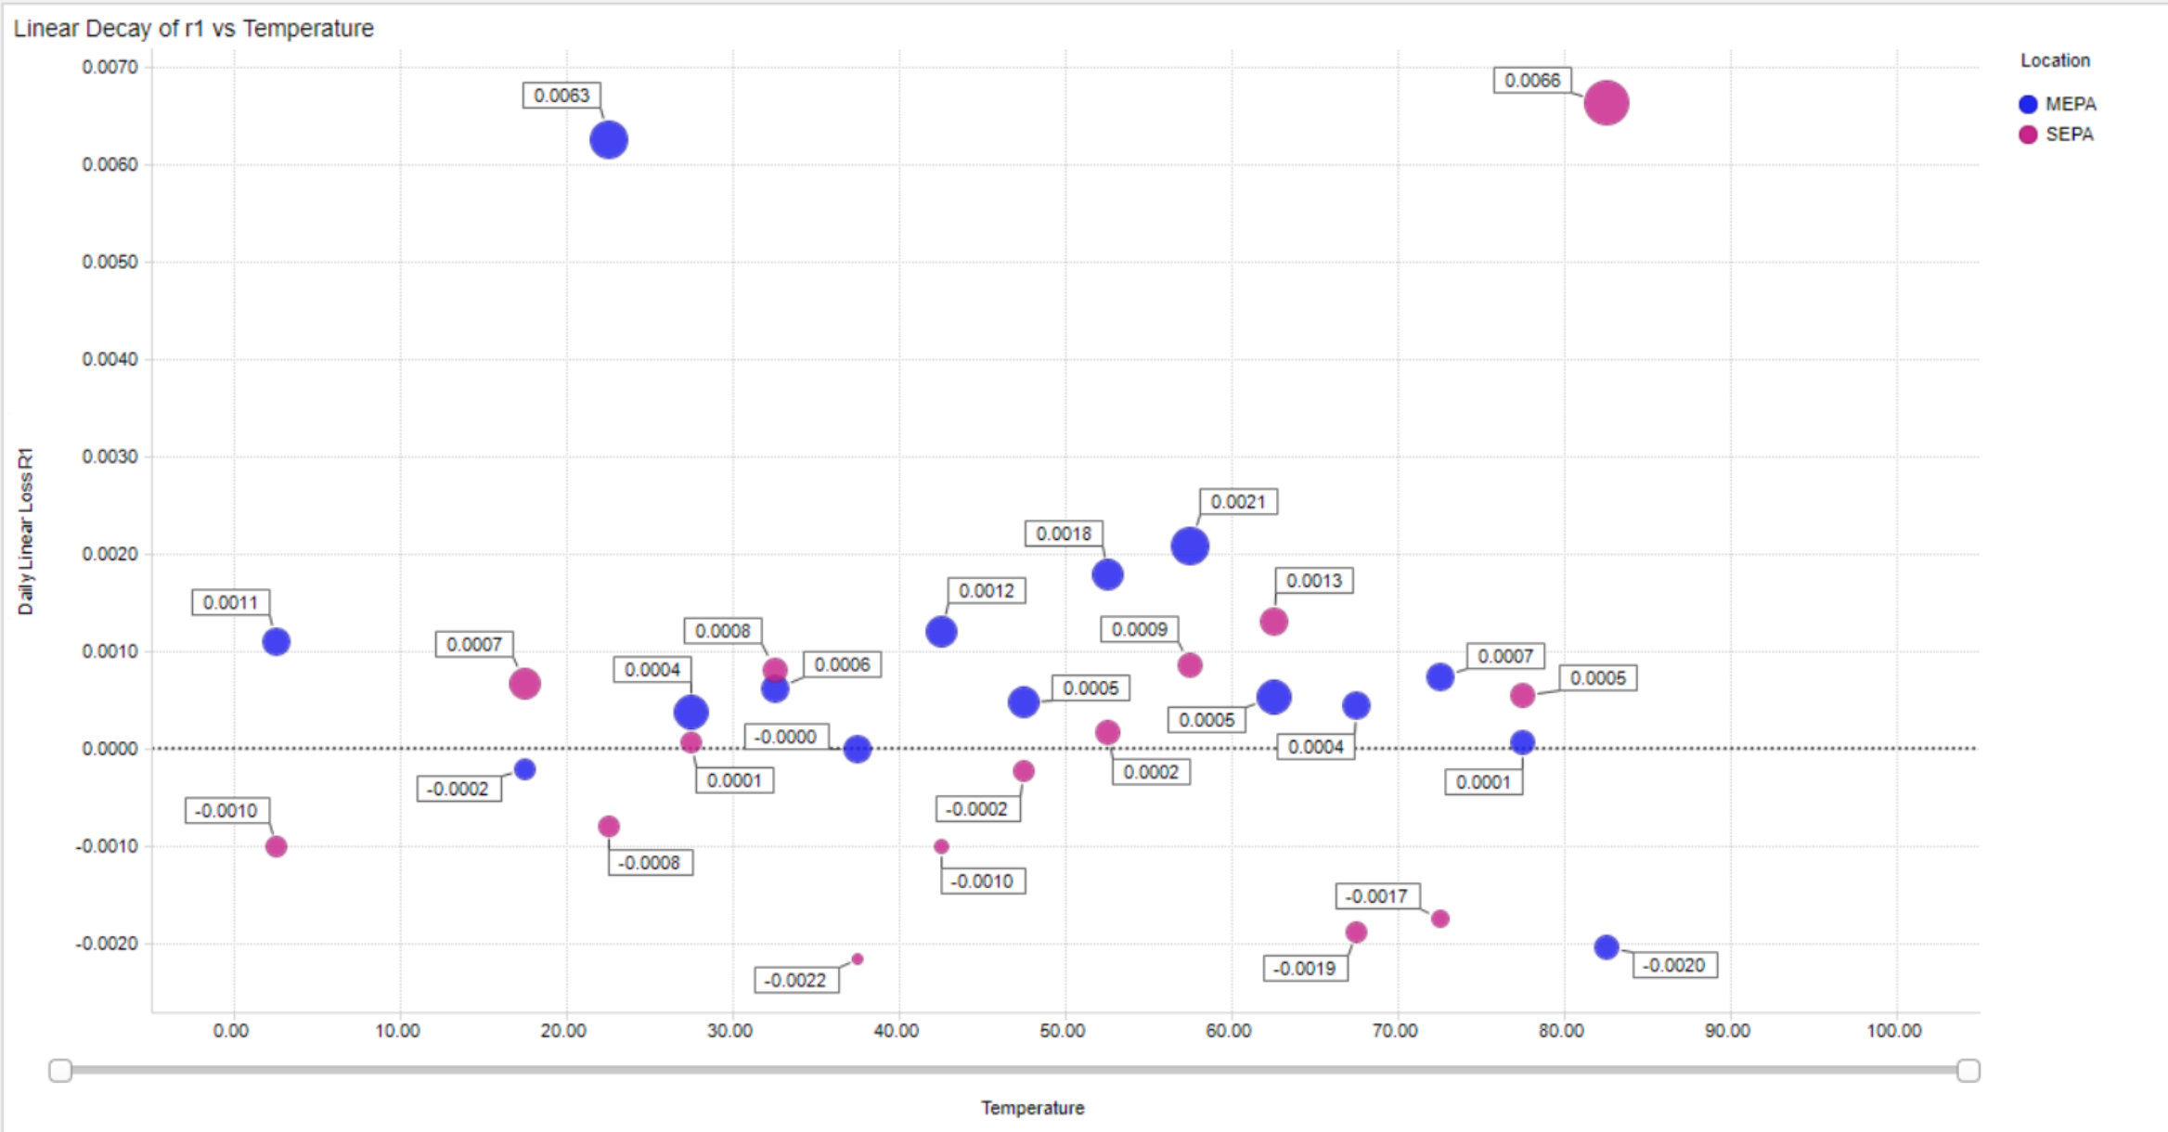
MEPA & SEPA Behavior Over Temperature

Slide 16
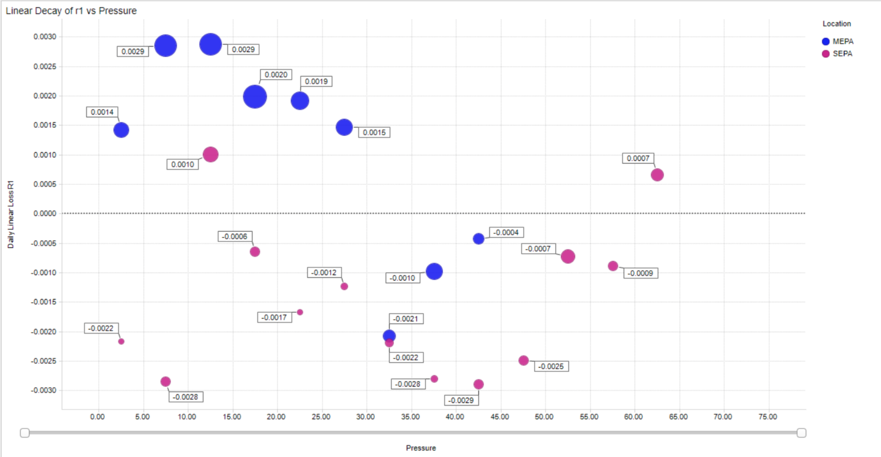
MEPA & SEPA Behavior Over Pressure

Slide 17
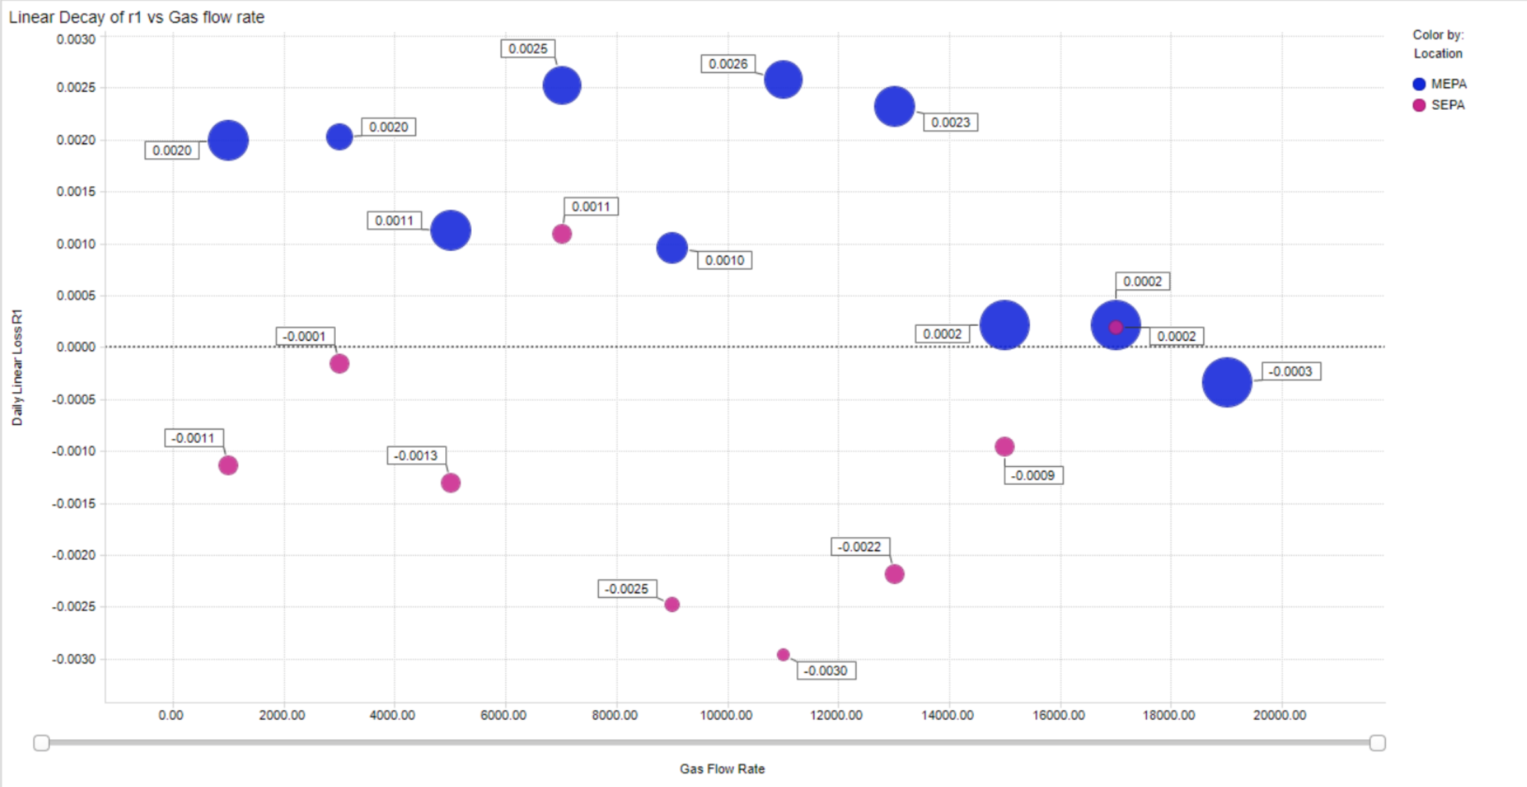
MEPA & SEPA Behavior Over Gas flow rate

Slide 18
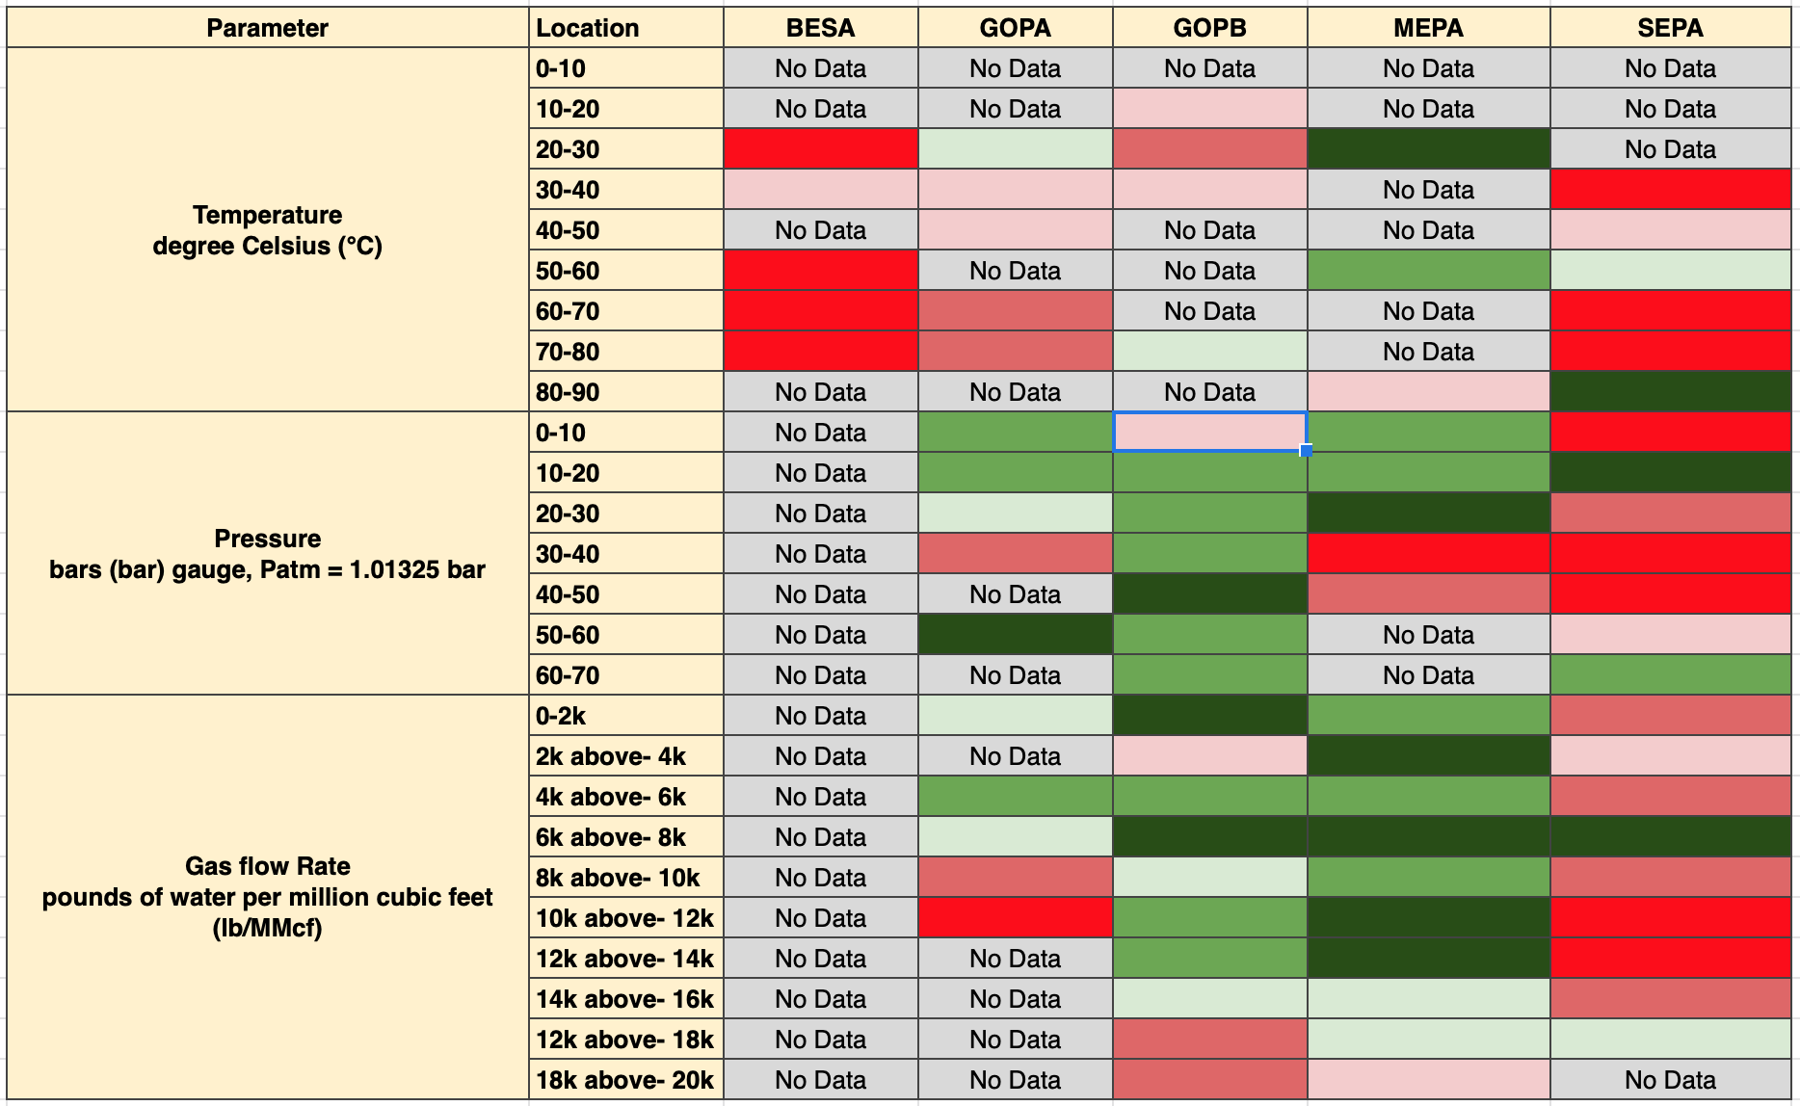
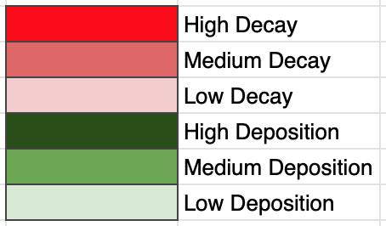
Summary of Observations

Slide 19
Blockers/ Data Limitations
Low frequency of Inspection data.
Unavailability of data for major factors like moisture content, pH, inhibitor etc.
Miscellaneous factors affecting correctness of Inspection data like depositions on flow lines.
Calibration of sensor.

Slide 20
Questions
Inhibitor Is inhibitor refers to the thin film/layer/coating inside the pipe? If we have CS as parent material, then do we have diff inhibitor for diff welds? If yes, then how to see this in data? Do we have data for Inhibitor availability/ efficiency? Are we using any formula to calculate it?
Standard Corrosion Model Kt, Fugacity factor, pH factor and wall shear stress reference table. Calculation of pH using KIV.
Weld Microstructure Do we have data for any flow line which has gone into micro-structural change? Is there any flag which tells PWC major factor for a specific weld, like PWC accelerated by high CO2 at a specific geo location?

